Slide 1
DATA STORY TELLING & STATISTICAL VALIDATION
ApexPlanet Data Analytics Internship
Prepared by: Tenali Kavya
Sales Performance Analysis using Python, SQL & Power BI

Slide 2
Project Objective
Analysis sales transaction data to identify patterns, trends and business opportunities.
Transform analysis findings into a clear business story for decision-making
Validate one important business insight using a statical test.

Slide 3
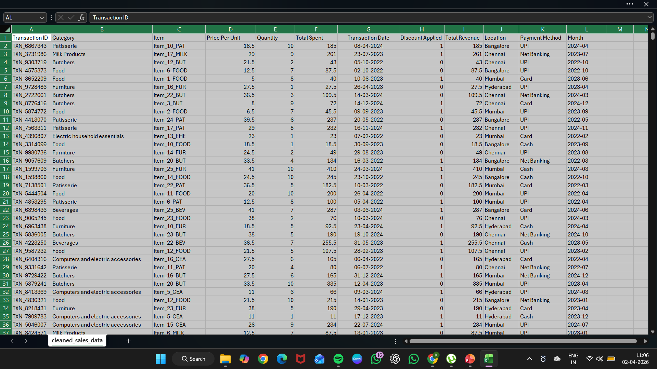
Dataset Overview
Columns used:
Transaction ID, Category, Item, Price per Unit, Quntity, Total Spent, Payment Method, Transaction Date, Discount Applied.
Workflow:
Cleaned in Google Colab → Queried in MySQL Workbench →
Visualized with Python statistics.

Slide 4
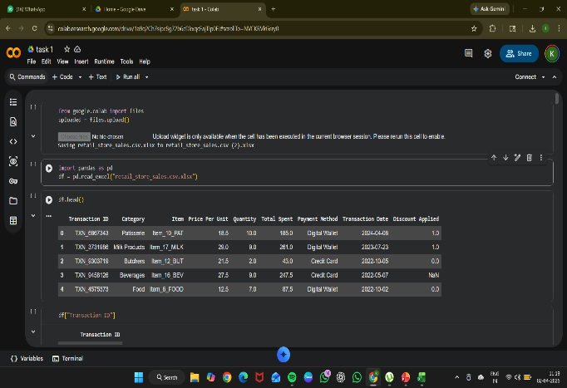
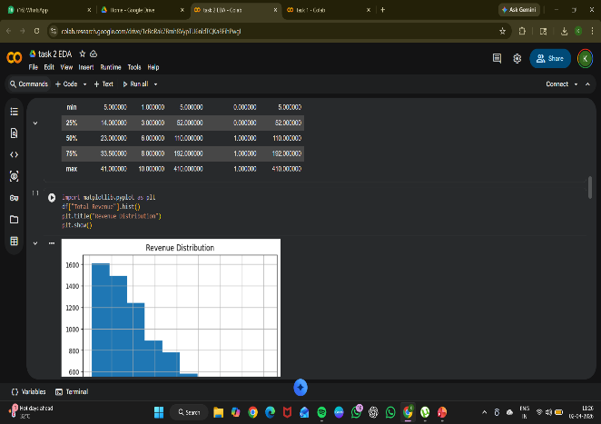
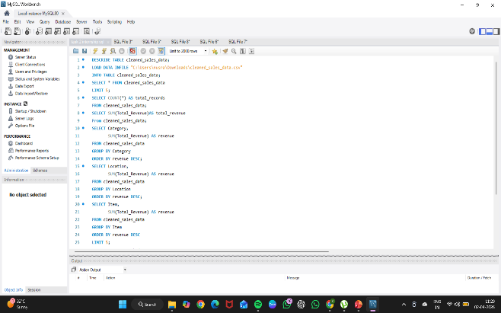
Total & Technologies
Power BI
Python
Google Colab
MySQL Workbench
Power BI
Pandas
Colab
Python EDA
SQL

Slide 5
Key Performance Indicators
Total Slaes/Total: 15,52,071
Total Transactions: 12,575
Total Quantity Sold: 68,474
Average Order Values: 123.42

Slide 6
Key Business Insights
Highest sales month: January
Top Performing item: Item_25_FUR
Best category by sales: Butchers
Most used payment method: Cash
Discount impact: No significant effect on average amount

Slide 7
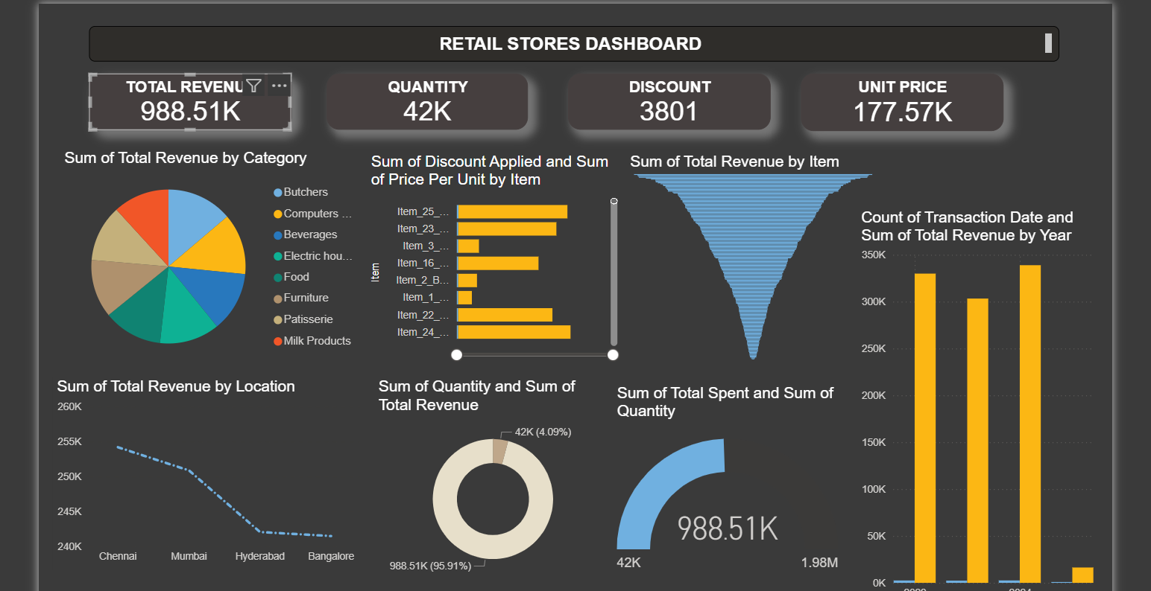
Interactive Dashboard

Slide 8
Business Recommendations
Focus promotions on high-performing products and categories.
Strengthen inventory planning during peak sales months.
Use product/category insights to improve business strategy.
Optimize payment options based on customer preference.

Slide 9
Statistical Validation
Business Question: Does discount significantly affect average sales amount?
Null Hypothesis (H): No significant difference in average sales amount between discounted and non-discounted transactions.
Alternative Hypothesis(H): Significant difference exists between the two groups.
Test Used: Independent Sample T-Test
T-Statistic: 0.254
P-Value: 0.799
Conclusion: Since p-value > 0.05, discount did not significantly affect average sales amount.

Slide 10
Conclusion
This project combined DataCleaning,
EDA,
SQL querying,
Dashboarding,
Storytelling,
Hypothesis testing.
It demonstrates a complete end-to-end analysis workflow.
Thank You.

